Slide 1
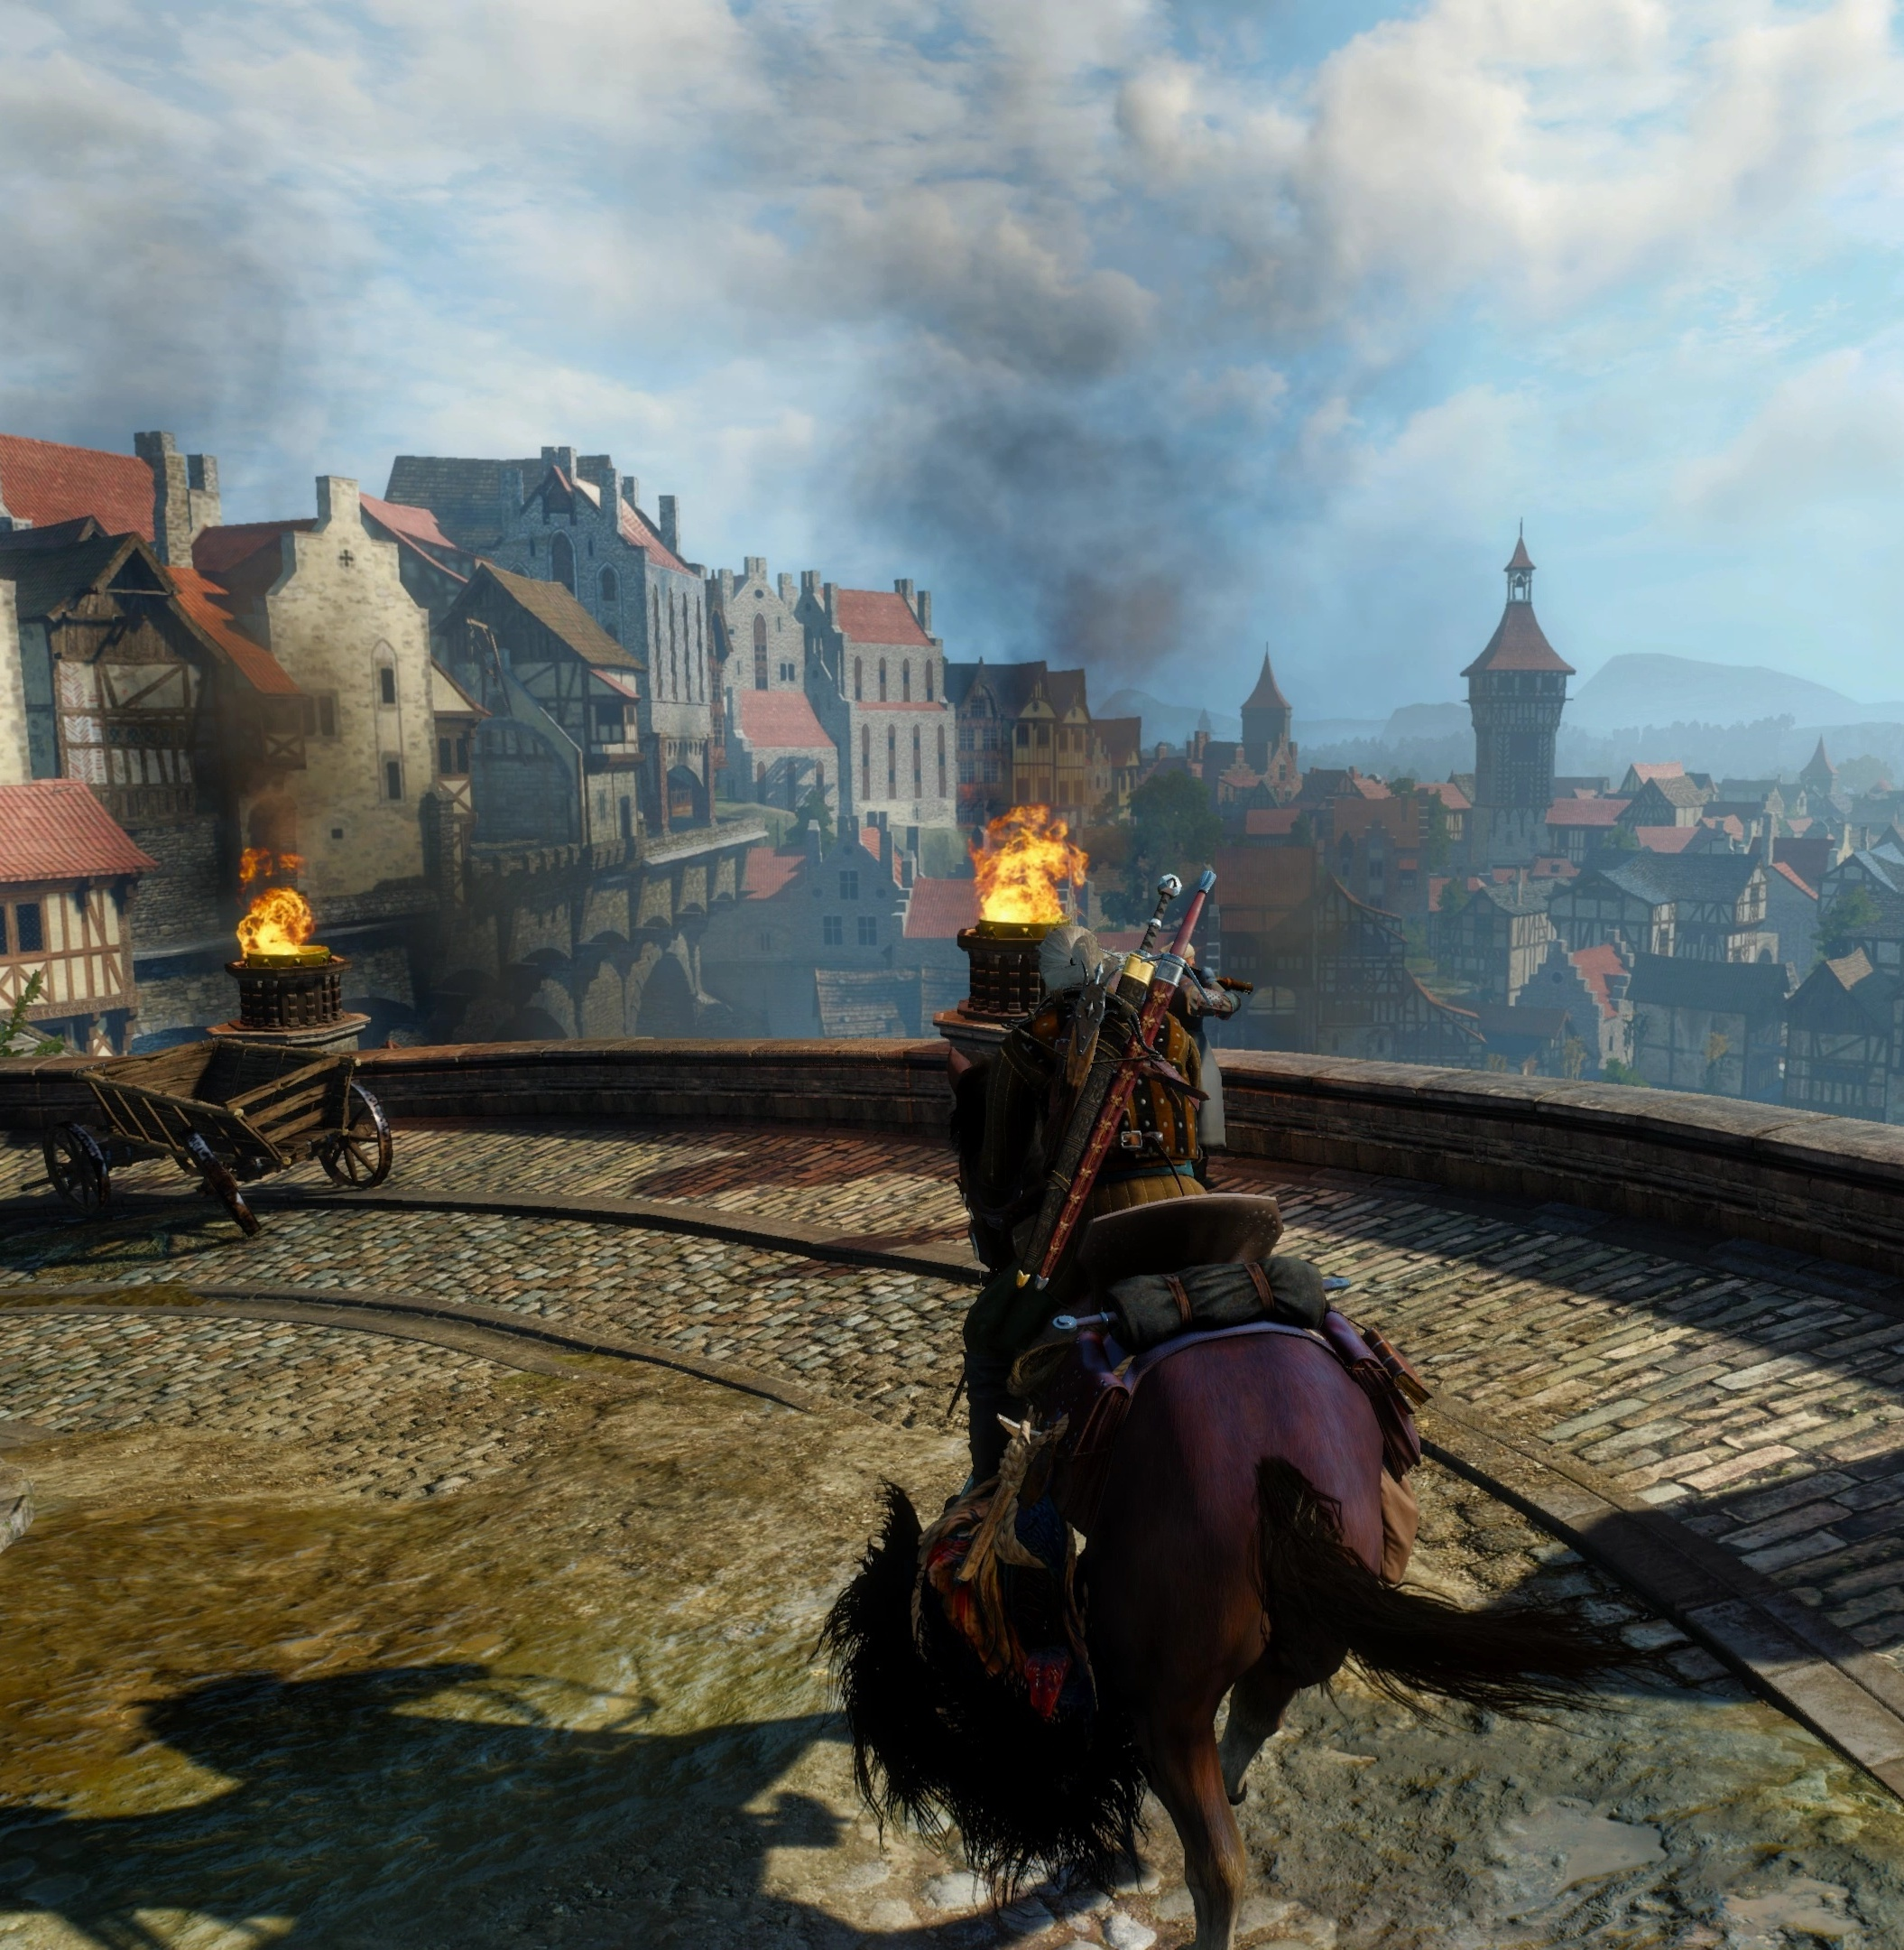
ENGLISH FOR COMPUTER SCIENCE
Algorithms and
Techniques in
Video Game
Optimization
A case study from The Witcher 3: Wild Hunt
Notes:
Speaker 1 | Section 1 · 0:00–1:45
Who here plays video games? What kinds of games do you play?
I’ve always been fascinated by video games. Like other forms of media, they allow you to explore new places and experience interesting stories, but they are interactable in a way that is unique to the art form. They’re part of the reason I chose to study computer science. I wanted to understand how something on a screen could feel like a place you could actually go and explore.
Sources
Novigrad gameplay still · GamePro / CD Projekt Red · https://www.gamepro.de/galerien/the_witcher_wild_hunt,99471.html

Slide 2
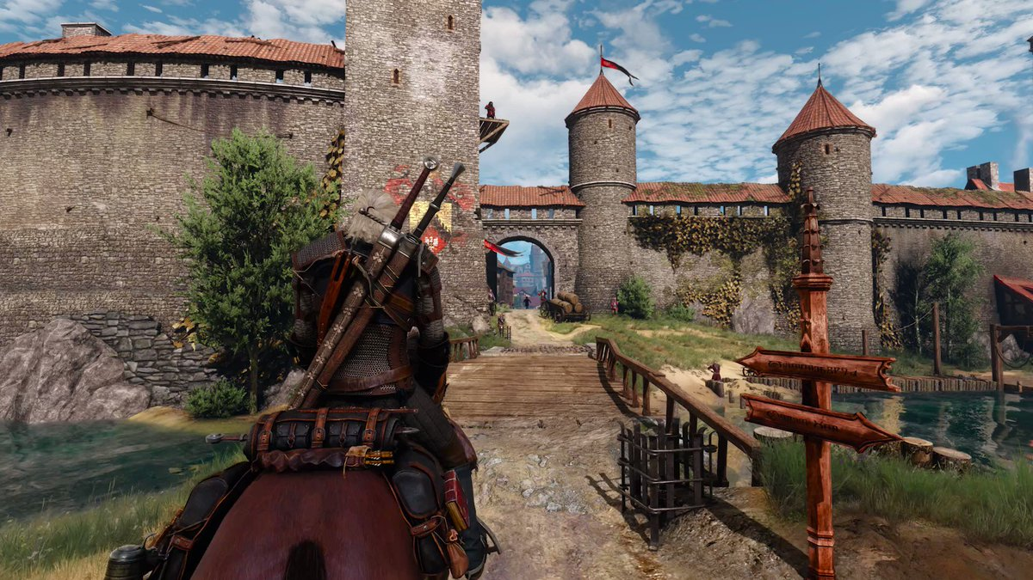
ENTERING NOVIGRAD
At the city gate
Rendering
When should we draw
the guard?
Collision detection
What stops him at
a wall?
Pathfinding
How could he get
around it?
Gameplay still · CD Projekt Red
02
Notes:
Speaker 1 | Section 1 · continued
Some of my favourites are open-world games. One of the things I love about them is seeing a town or a castle in the distance and realising I can just go there. Take The Witcher 3. You can ride toward Novigrad, a major city in the game, see its towers and walls in the distance, and keep going until you’re close enough to see a guard at the gate. It feels like one continuous place.
But how can the game keep track of such an enormous world? We’ll use the guard example to follow three decisions the game has to make. First, when should it draw him, and how much detail does it need? Then, how does his individual model interact with the rest of the world? Finally, how could he find his way around to reach the player?
Sources
Gameplay still · CD Projekt Red · https://x.com/thewitcher/status/1615363448505786368
https://www.youtube.com/watch?v=xx8kQ4s5hCY

Slide 3
RENDERING AT SCALE
A visibility test in The Witcher 3
One development scene, one viewpoint
62,000+
<500
61 MB
pieces of static
geometry in the scene
pieces visible from
the test viewpoint
of precomputed
visibility data loaded
Source · CD Projekt Red and Umbra, GDC 2014
03
Notes:
Speaker 1 | Section 2 · 1:45–2:30
Before we get to the guard, let’s think about the scale of the world around him. A building you pass in a few seconds might be made up of many separate pieces of geometry. The same goes for the bridge, the street, and the buildings beyond it. Put all of that together and the engine has a lot of objects to consider.
In a development test for The Witcher 3, CD Projekt Red showed a scene containing more than sixty-two thousand pieces of static geometry. From the viewpoint they tested, fewer than five hundred were visible. The test also loaded sixty-one megabytes of precomputed visibility data.
Those figures describe the game’s wider visibility system. Let’s look at one specific visibility test, starting with a simple question. Is the object even inside the camera’s view?
Sources
https://media.gdcvault.com/GDC2014/Presentations/Bushnaief_Jasin_Solving_Visibility_In.pdf

Slide 4
FRUSTUM CULLING
The guard is outside the camera’s view
View frustum
The 3D volume the camera
can see.
Gate
Bounding box
Guard
A simple box enclosing
the guard.
View frustum
Entirely outside → skip drawing
Camera
Simplified overhead view of the gate
04
Notes:
Speaker 1 | Section 3 · 2:30–5:15
Imagine the player is standing on the road outside the capital. The city gate is off to his right, but the camera is pointing straight down the road. The guard is still standing at the gate. From where the camera is pointing, though, he’s completely off-screen.
The engine can test for that using the camera’s view frustum. In three dimensions, you can picture it as a pyramid with the tip cut off. It’s narrow close to the camera and gets wider farther away. The camera’s position and direction determine where that volume sits in the world. So when you rotate the camera, the volume rotates with it.
Now imagine putting a simple box around the guard. We call that a bounding box. The engine can test the box against the boundaries of the frustum. If the whole box is outside, the guard can be skipped when drawing this view. Testing a simple box gives us a quick way to rule him out before doing the work of drawing him.
Sources
https://dev.epicgames.com/documentation/en-us/unreal-engine/visibility-and-occlusion-culling-in-unreal-engine

Slide 5
FRUSTUM CULLING
The camera turns toward the gate
Same guard, same position
Only the camera direction
has changed.
Gate
The box enters the frustum
Guard
The renderer keeps the guard
as a candidate for drawing.
View frustum
Intersects the view → keep testing
Camera
Simplified overhead view of the gate
05
Notes:
Speaker 1 | Section 3 · continued
What happens when we turn the camera toward the gate? The guard’s box starts to enter the frustum. Even if only part of the box crosses the edge, the engine keeps him as a candidate for drawing. Otherwise, a guard who was already partly on-screen could disappear at the edge of the picture.
This is frustum culling. The guard stays in the same spot through the whole example. The camera turns, and that changes whether the renderer needs to consider him. Here’s what that same test looks like in a running game engine.
Sources
https://dev.epicgames.com/documentation/en-us/unreal-engine/visibility-and-occlusion-culling-in-unreal-engine

Slide 6
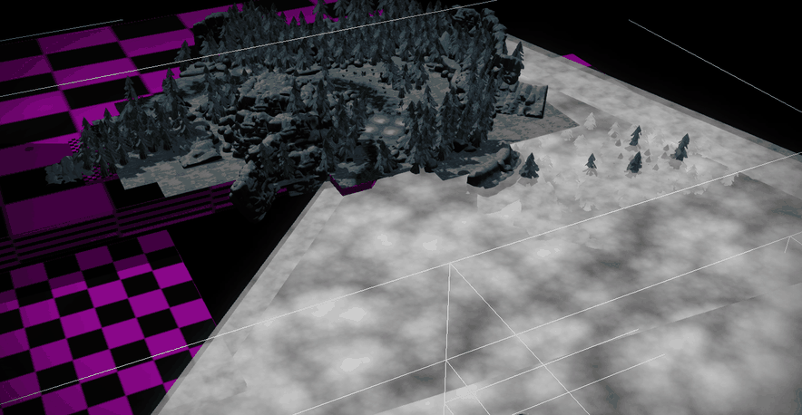
FRUSTUM CULLING
Frustum culling in a running engine
Camera frustum
The white outline marks
the viewing volume.
Watch the scenery
Trees and rocks drop out
as the view moves away.
Engine debug capture · Tobias Garpenhall, R.O.S.E.
06
Notes:
Speaker 1 | Section 3 · continued
This is a debug view of the R.O.S.E. engine. Watch the group of trees and rocks as the camera view moves. The engine skips groups that fall outside its frustum.
Once something is in view, the engine still has to decide how much detail to draw.
Source · Tobias Garpenhall, R.O.S.E. · https://www.tobiasgarpenhall.com/rose
Capture resized and frame-sampled for playback.

Slide 7
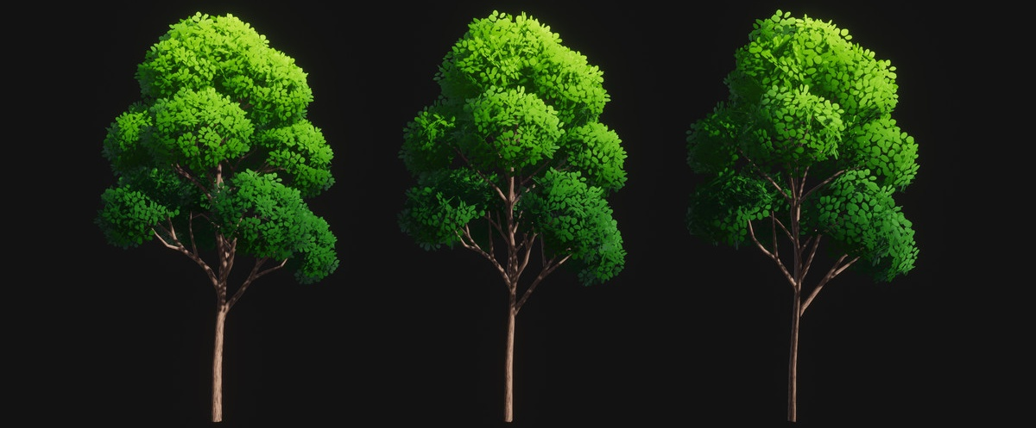
LEVEL OF DETAIL
One tree at three levels of detail
Use a simpler mesh when the tree takes up less screen space.
LOD 0
LOD 1
LOD 2
4,918 triangles
2,834 triangles
1,494 triangles
AZURE Nature tree asset shown at equal size · Raygeas / Unity Asset Store
07
Notes:
Speaker 1 | Section 4 · 5:15–7:00
Think about a tree beside the road into Novigrad. From across the field, you can make out its trunk and the shape of its crown. As you ride closer, you start to see individual branches. Once you’re right beside it, you can see details that would have been almost impossible to pick out from the other side of the field.
An engine can take advantage of this with level of detail, or LOD. The tree can have several versions of its 3D model. When it takes up a small part of the screen, the engine can use a simpler mesh with fewer triangles. As it gets bigger on screen, the engine can switch to a more detailed version. Here the same game asset is shown at three levels. The most detailed version has nearly five thousand triangles. The simplest has about fifteen hundred.
The tricky part is deciding when to switch. If the two versions have very different outlines, you might see the tree suddenly change shape as you ride past. A good simpler model keeps the shape you recognise from a distance while cutting detail you’d struggle to see anyway.
By now, the player is close enough to make out the guard at the gate. Imagine the guard spots him and needs to come over, but there’s a wall between them. How does the game work out where he can move and which way he should go? My partner will take it from here.
Sources
https://www.nvidia.com/en-us/geforce/news/the-witcher-3-wild-hunt-graphics-performance-and-tweaking-guide/#foliagevisibilityrange
https://dev.epicgames.com/documentation/en-us/unreal-engine/optimizing-lod-screen-size-per-platform-in-unreal-engine
https://assetstore.unity.com/packages/3d/vegetation/azure-nature-167725

Slide 8
COLLISION DETECTION
The shapes that stop a character
Collider
A simple shape used to
test for contact.
Character and wall
A capsule and a box can
represent solid objects.
Capsule
Wall box
Illustrative collision shapes at the gate
08
Notes:
Speaker 2 | Section 5 · 7:00–10:00
Let’s stay at the gate. Imagine you’re controlling Geralt and you try to walk straight into the stone wall. You expect him to stop. It’s such a basic part of playing a game that you’d probably only think about it if he walked right through.
The game needs a way to represent the solid parts of that scene. A character can be represented by a capsule, which is like a cylinder with rounded ends. A straight section of wall can be represented by a box. We call these shapes colliders. The wall you see might have individual stones, cracks, and an uneven surface. For a movement check, a simple shape can often capture enough of the wall to stop the character where you’d expect.
Sources
https://box2d.org/doc_version_2_4/md__e_1_2github_2box2d__24_2docs_2collision.html

Slide 9
COLLISION DETECTION
Broad phase and narrow phase
Broad phase
Wall
Find objects that could collide
with the guard.
Narrow phase
Barrel
Test the candidate shapes
for actual contact.
Guard
Cart
100 objects → 4,950 possible pairs
Highlighted cells contain possible collisions.
Illustrative spatial grid
09
Notes:
Speaker 2 | Section 5 · continued
But look at how many things there are near a city gate. There might be walls, barrels, carts, and several characters moving at once. If we had a hundred objects and checked every possible pair, we’d have almost five thousand pairs to consider. Most of those objects could be nowhere near each other.
So collision detection often starts with a broad phase. Imagine dividing the area around the gate into a grid. We register objects in the cells their bounds overlap. When the guard moves, we look for possible collisions in the cells covered by his movement. That gives us a much shorter list. It might include the wall next to him and a barrel at the corner. A cart across the street can be left out of that check.
Then comes the narrow phase. Being in the same cell means two objects might touch. The engine tests the actual collision shapes to find out. The guard might be close to the barrel and still have enough room to pass. If his movement would bring his capsule into contact with the wall, the game can use that result to stop him or let him slide along it.
So we can check whether the guard has room to make a particular move. Now we have a bigger problem. Geralt is on the other side of the wall. The guard needs a route that gets him all the way there.
Sources
https://box2d.org/doc_version_2_4/md__e_1_2github_2box2d__24_2docs_2collision.html

Slide 10
NAVIGATION
Where can the guard walk?
Navigation mesh
Connected surfaces that
characters can walk on.
Around the wall
The walkable surface
continues past its open end.
Guard
Geralt
Wall
Walkable area
Simplified navigation mesh at the gate
10
Notes:
Speaker 2 | Section 6 · 10:00–13:00
CD Projekt Red’s tools describe how characters in The Witcher 3 use a navigation mesh. Think of it as a map of the walkable surfaces. The road and the open gateway can be part of that map. The space occupied by the wall blocks the direct route. To show how an algorithm can search for a route, we’ll simplify our gate into a grid and use A-star.
Sources
https://cdprojektred.atlassian.net/wiki/spaces/W3REDkit/pages/16351233
https://ai.stanford.edu/~nilsson/OnlinePubs-Nils/PublishedPapers/astar.pdf

Slide 11
A* PATHFINDING
Which square should A* explore first?
Cost so far
How far the guard would walk
to reach a position.
Estimated cost remaining
How far it might still be
to Geralt.
Guard
Geralt
Wall
A* explores the most promising
positions first.
Simplified A* grid example
11
Notes:
Speaker 2 | Section 6 · continued
Imagine the guard can see Geralt across the street, but a wall blocks the direct route. On our grid, the guard can move through the open squares. The question is which of those squares he should try first.
A-star looks at two things for each position it could explore. How far would the guard have to walk to get there? And how far might he still have to go to reach Geralt? That second part is an estimate, called a heuristic. Here, we estimate the remaining distance by looking at how far apart the two positions are on the grid.
At first, the square straight ahead looks like a good choice. It’s a short step and it brings the guard closer to Geralt. A-star explores that square first, then finds that the next square is blocked by the wall.
Sources
https://ai.stanford.edu/~nilsson/OnlinePubs-Nils/PublishedPapers/astar.pdf

Slide 12
A* PATHFINDING
The route around the wall
The next square is blocked
A* keeps other positions
available to explore.
A route through open squares
Once it reaches Geralt, A* can
trace the route back to the guard.
Guard
Geralt
Wall
Simplified A* grid example
12
Notes:
Speaker 2 | Section 6 · continued
The search still remembers the other positions it could explore. It can try a direction that takes the guard to the open end of the wall, even if that means moving a little farther from Geralt at first. Once the search reaches Geralt, it can trace the route back to where the guard started.
So the estimate helps A-star decide where to look first. The open squares tell it where the guard can actually go.
Sources
https://ai.stanford.edu/~nilsson/OnlinePubs-Nils/PublishedPapers/astar.pdf

Slide 13
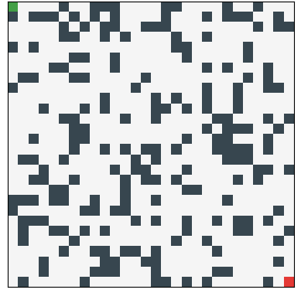
A* PATHFINDING
A* expands through a maze
Start
The search begins in the upper left.
Explored squares
Blue spreads as A* checks more positions.
Final route
Gold shows the route after A* reaches the goal.
Recorded A* search trace · graphfinder
13
Notes:
Speaker 2 | Section 6 · continued
Here’s a larger example from a running A-star search. The blue squares show the positions it has explored. When it reaches the red goal, the gold line reveals the route it found.
Source · graphfinder / José L. Salmeron · https://graphfinder.github.io/visualization/#animate_grid-watch-the-search-explore
Original capture cropped to the grid and frame-sampled for playback.

Slide 14
One encounter
in Novigrad
Frustum culling
Should we draw it for this view?
Level of detail
How detailed should it be?
Collision detection
What could block this move?
Pathfinding
Which route reaches the goal?
Notes:
Speaker 2 | Section 7 · 13:00–14:00
Think back to that ride into Novigrad. You turn the camera and the gate comes into view. You ride closer and start to make out the details of the trees along the road. You reach the wall and Geralt stops where you expect him to. If the guard needs to reach you, there’s a way for the game to work out a route around that obstacle.
As a player, you experience all of that as one ordinary moment. You’re riding into a city. As a developer, you can break that moment into smaller decisions about what to draw, what to check, and where to search.
At the start, we talked about why game worlds can feel like places we can actually explore. What I find fascinating is that even a short ride through a city gives us this much to explain. Thank you.
Sources
Novigrad gameplay still · GamePro / CD Projekt Red · https://www.gamepro.de/galerien/the_witcher_wild_hunt,99471.html

Slide 15
References
CD Projekt Red and Umbra
Solving Visibility in REDengine 3 · GDC 2014
Epic Games
Visibility and occlusion culling
NVIDIA
The Witcher 3 foliage visibility and detail
Box2D
Broad-phase and narrow-phase collision checks
CD Projekt Red REDkit
Generating navigation data
Hart, Nilsson and Raphael
A Formal Basis for the Heuristic Determination of Minimum Cost Paths
Tobias Garpenhall
R.O.S.E. frustum-culling debug capture
Raygeas
AZURE Nature tree asset · Unity Asset Store
graphfinder
A* maze search animation
Gameplay stills · CD Projekt Red and GamePro
15
Notes:
Sources
city · https://www.gamepro.de/galerien/the_witcher_wild_hunt,99471.html
gate · https://x.com/thewitcher/status/1615363448505786368
gameplay · https://www.youtube.com/watch?v=xx8kQ4s5hCY
gdc · https://media.gdcvault.com/GDC2014/Presentations/Bushnaief_Jasin_Solving_Visibility_In.pdf
frustum · https://dev.epicgames.com/documentation/en-us/unreal-engine/visibility-and-occlusion-culling-in-unreal-engine
foliage · https://www.nvidia.com/en-us/geforce/news/the-witcher-3-wild-hunt-graphics-performance-and-tweaking-guide/#foliagevisibilityrange
lod · https://dev.epicgames.com/documentation/en-us/unreal-engine/optimizing-lod-screen-size-per-platform-in-unreal-engine
collision · https://box2d.org/doc_version_2_4/md__e_1_2github_2box2d__24_2docs_2collision.html
nav · https://cdprojektred.atlassian.net/wiki/spaces/W3REDkit/pages/16351233
astar · https://ai.stanford.edu/~nilsson/OnlinePubs-Nils/PublishedPapers/astar.pdf
rose · https://www.tobiasgarpenhall.com/rose
azure · https://assetstore.unity.com/packages/3d/vegetation/azure-nature-167725
graphfinder · https://graphfinder.github.io/visualization/#animate_grid-watch-the-search-explore

